Slide 1

Heat Illness Prevention

Slide 2


Heat Illness Prevention Plan
The employer shall establish, implement, and maintain, an effective heat illness prevention plan.
In addition to initial training, employees will be retrained annually.
Training records will be maintained and will include the date of the training, who performed the training, who attended the training, and the subject(s) covered.

Slide 3
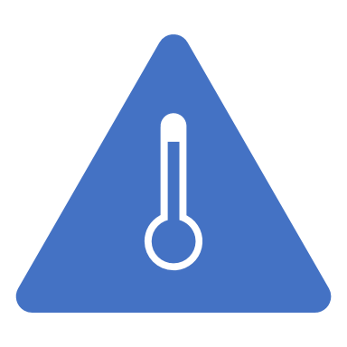
Effective Heat Illness Prevention Plan
Provision of water
Access to shade
High-heat procedures
Emergency Response Procedures
Acclimatization
Training

Slide 4

Employee Training
The environmental and personal risk factors that cause heat related illnesses;
The employer’s procedures for identifying, evaluating and controlling exposures to the environmental and personal risk factors for heat illness;
The importance of frequent consumption of small quantities of water, up to 4 cups per hour under extreme conditions of work and heat;
The importance of acclimatization;
The different types of heat illness and the common signs and symptoms of heat illness;

Slide 5
Employee Training
The importance of immediately reporting to the employer, directly or through the employee’s supervisor, symptoms or signs of heat illness in themselves, or in co-workers.
The employer’s procedures for responding to symptoms of possible heat illness, including how emergency medical services will be provided should they become necessary;
Procedures for contacting emergency medical services, and if necessary, for transporting employees to a point where they can be reached by an emergency medical service provider;
How to provide clear and precise directions to the work site.

Slide 6

Environmental Risk Factors
Air temperature: During high heat
Relative humidity: High heat may also be accompanied by high humidity.
Radiant heat from the sun and other sources
Conductive heat sources such as the ground
Air movement: Air movement can also cause heat to be transferred to and from the body
Workload severity and duration

Slide 7

Personal Risk Factors
Age, weight, degree of physical fitness
Degree of acclimatization, metabolism
Use of alcohol or drugs
… as well as a variety of
medical conditions such as
hypertension all affect a
person’s sensitivity to heat.
Notes:
7
Photo: Microsoft Clip Art

Slide 8
Personal Risk Factors
Prior heat injury predisposes an individual to additional injury
Type of clothing worn must be considered
Notes:
8
Photo: Microsoft Clip Art

Slide 9
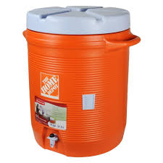
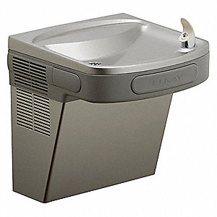
Access to Water
Potable drinking water must be made available at no cost to the employee.
    Maintain, at all times, sufficient quantities of pure and cool potable drinking water (i.e. enough to provide at least one quart per employee per hour for the entire shift).

Slide 10
Access to Water
    Locate the water containers as close as practicable given the working conditions and layout of the worksite.
    Keep it readily accessible, move it with the workers!
    Encourage the frequent drinking of water.

Slide 11

Shade Up:
When the temperature exceeds 80° F
    Have and maintain one or more areas of shade at all times, when employees are present.
    Locate the shade as close as practical to the area where employees are working.

Slide 12
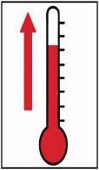
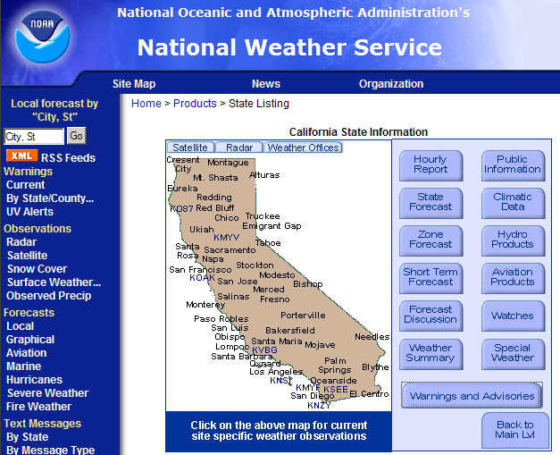
Monitor the Weather www.nws.noaa.gov
    Instruct supervisors to track the weather of the job site [by monitoring predicted temperature highs and periodically using a thermometer.]
    Determine, and instruct supervisors, on how weather information will be used to modify work schedule, increase number of water and rest breaks or cease work early if necessary.

Slide 13
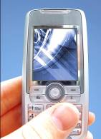
When the temperature equals or exceeds 95° F
You must implement additional preventive measures:
Ensure effective communication (by voice, observation or electronic means).

Slide 14
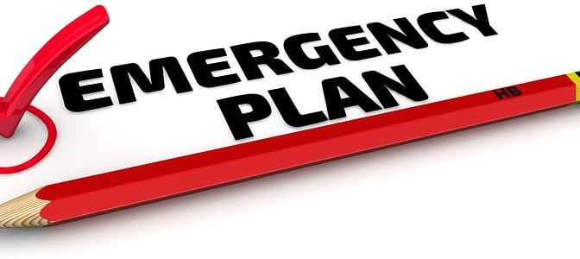
Emergency Response Procedures
Ensure effective communication
Respond to signs and symptoms of possible heat illness
  Supervisor to take immediate, appropriate action
  If indicators of serious heat illness, implement emergency response procedures

Slide 15
Emergency Response Procedures
Respond to signs and symptoms of possible heat illness
  Employees exhibiting or reporting signs or symptoms of heat illness shall be monitored and not left alone. Onsite first aid or appropriate emergency medical services shall be offered.
  Contact emergency medical services and ensure that clear and precise directions to the site can be provided

Slide 16

Address Lack of Acclimatization
    Determine how your company will:
  Lessen the intensity and/or shift length of the newly-hired employees’ work during a two or more week break-in period;
  Be extra-vigilant with your employees to recognize immediately symptoms of possible heat illness.

Slide 17

Signs of Heat Related Illness

Slide 18
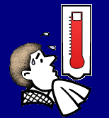
Heat Disorders and Health Effects
Heat rash
Heat cramps
Heat exhaustion
Heat stroke
Notes:
18
Illustration: OSHA Technical Manual

Slide 19
Heat Rash
Most common problem in hot work environments
Symptoms
  Prickly heat is manifested as red papules and usually appears in areas where the clothing is restrictive
  Sweat cannot freely evaporate from the skin and sweat ducts become plugged
Notes:
19
Photo: Microsoft Clip Art

Slide 20
Heat Rash
Prevention
  Prevented by breathable clothing, thorough cleansing of the skin
Treatment
  Treated by keeping skin dry, use of cooled sleeping quarters, calamine lotion
Notes:
20
Photo: Microsoft Clip Art

Slide 21

Heat Cramps
May result after excessive water loss, sweating, dehydration
Symptoms
  Shriveled skin, sunken eyes, dry mouth and tongue
  Severe pain and cramps in legs and abdomen, fainting or dizziness, weakness, profuse sweating, and headaches
Notes:
21
Illustration: United States Navy

Slide 22
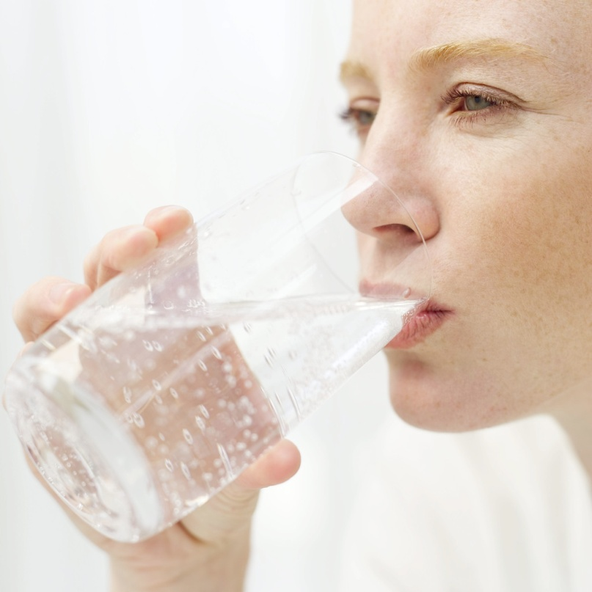
Heat Cramps
Treatment
  Increase fluid intake, increase salt intake, rest and move to a cool place
Notes:
22
Photo: Microsoft Clip Art

Slide 23
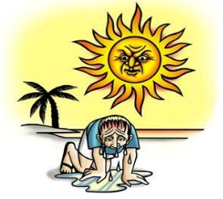
Heat Exhaustion
Blood moves toward outer body to remove heat.
Blood pools in the skin leaving less for the brain.
Symptoms
  Fatigue, headache, dizziness, profuse sweating, rapid pulse, thirst, loss of appetite, nausea, vomiting, and fainting
Notes:
23

Slide 24
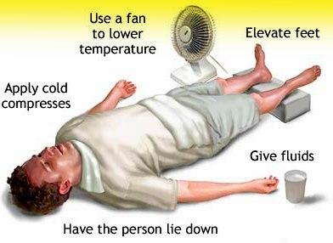
Heat Exhaustion
Treatment
  Get to the shade, cool off, increase fluids, cold wet towels or ice, fan, elevate legs above heart, loosen clothing, don’t give any liquids containing alcohol or caffeine, may need IV.
  If condition worsens, seek medical attention immediately.
  If left untreated, heat exhaustion can lead to HEAT STROKE.
Notes:
24
Photo: OSHA.gov

Slide 25
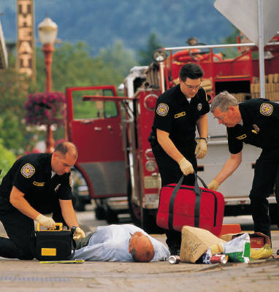
Heat Stroke
A medical emergency and a life threatening condition caused by the failure of the heat-regulating mechanisms of the body, due to high heat and humidity.
Core temperature rises, body stops sweating
Notes:
25
Photo: Microsoft Clip Art

Slide 26
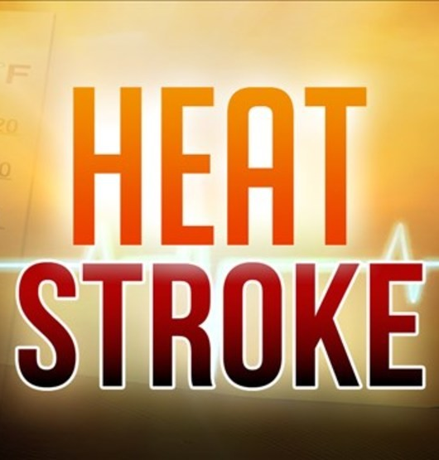
Heat Stroke
Symptoms
  Skin is hot and dry, flushed; rapid pulse; confusion; nausea; convulsions; unconsciousness
Notes:
26
Photo: OSHA.gov

Slide 27
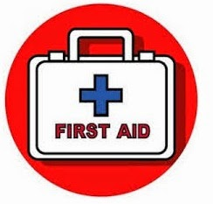
Heat Stroke
Treatment
  Remove to cooler location, loosen clothing, immerse in cool water, wrap in wet sheets, cold compresses to the head, neck and groin. SEEK MEDICAL ATTENTION IMMEDIATELY.
Notes:
27
Photo: Microsoft Clip Art

Slide 28


