Slide 1


Safety In The Workplace
The Empire Team Approach

Slide 2
Roles & Responsibilities of the Empire Team Members
Managers & Trainers
Provide the Resources, Support, Guidance, and leadership.
Dispatchers
Communicate & Transmit The Message.
Drivers
Receive the message, act and achieve goals

Slide 3





Safety Committee
Composed of 7 members.
Discussed most recent accidents.
Select the Employee of the Month.
We meet once a month.
Safety meetings topics.

Slide 4
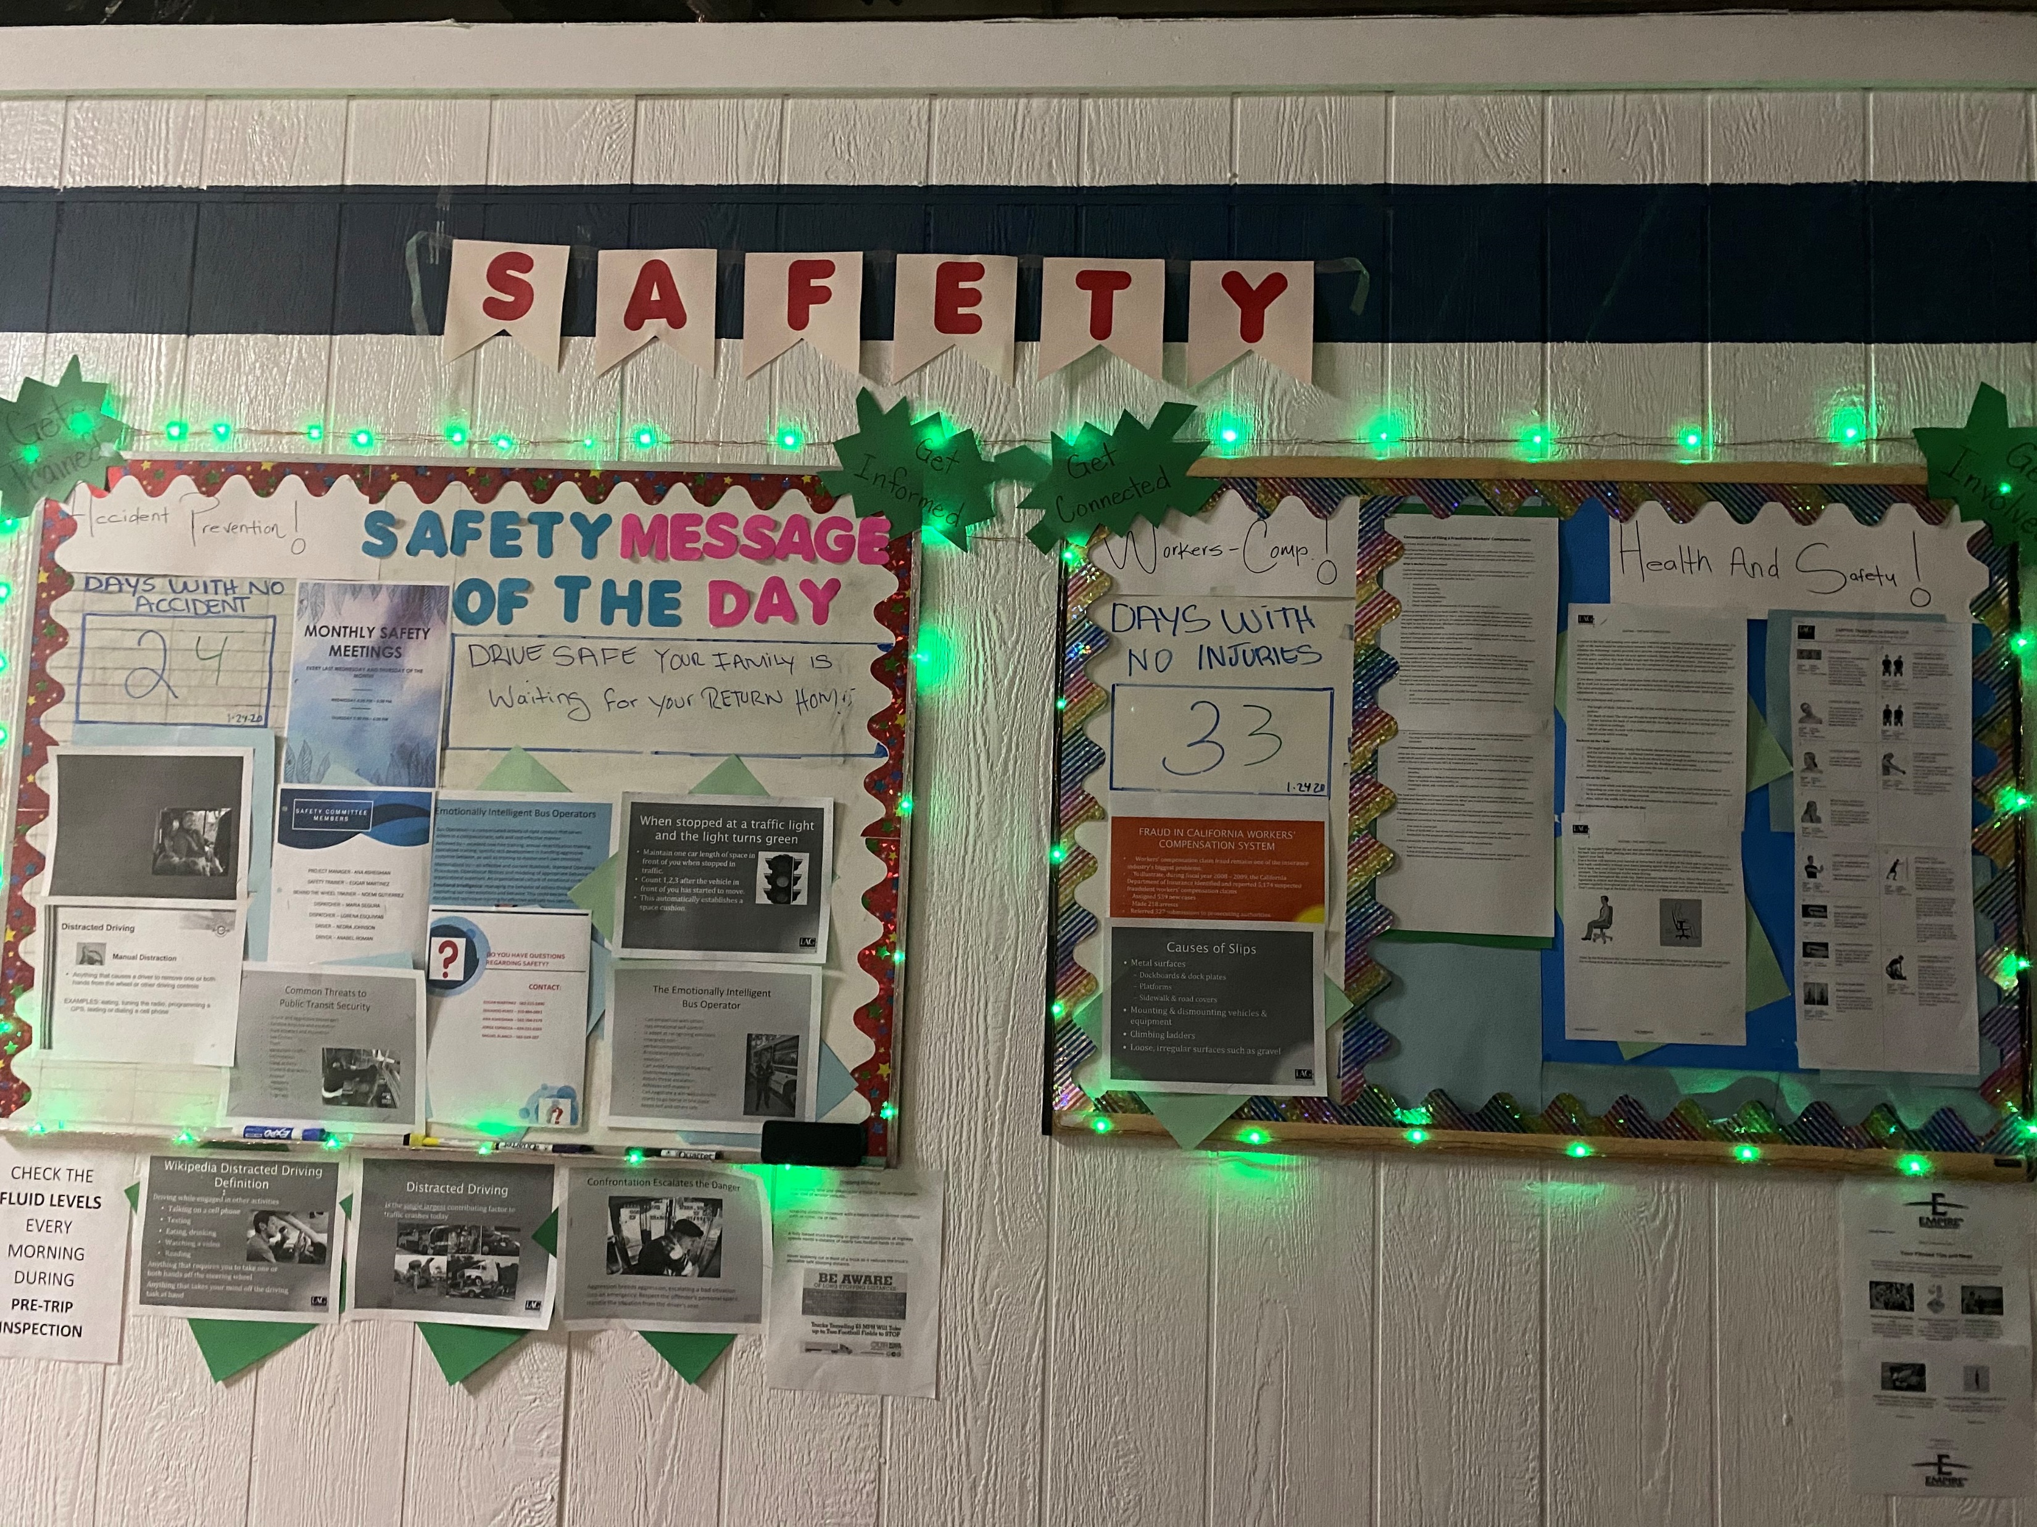
SAFETY BOARD
Days with no accident.
Days with no Injury.
Safety Message of the Day.
Promote Health.
Employee of the Month.
The Empire News Magazine

Slide 5
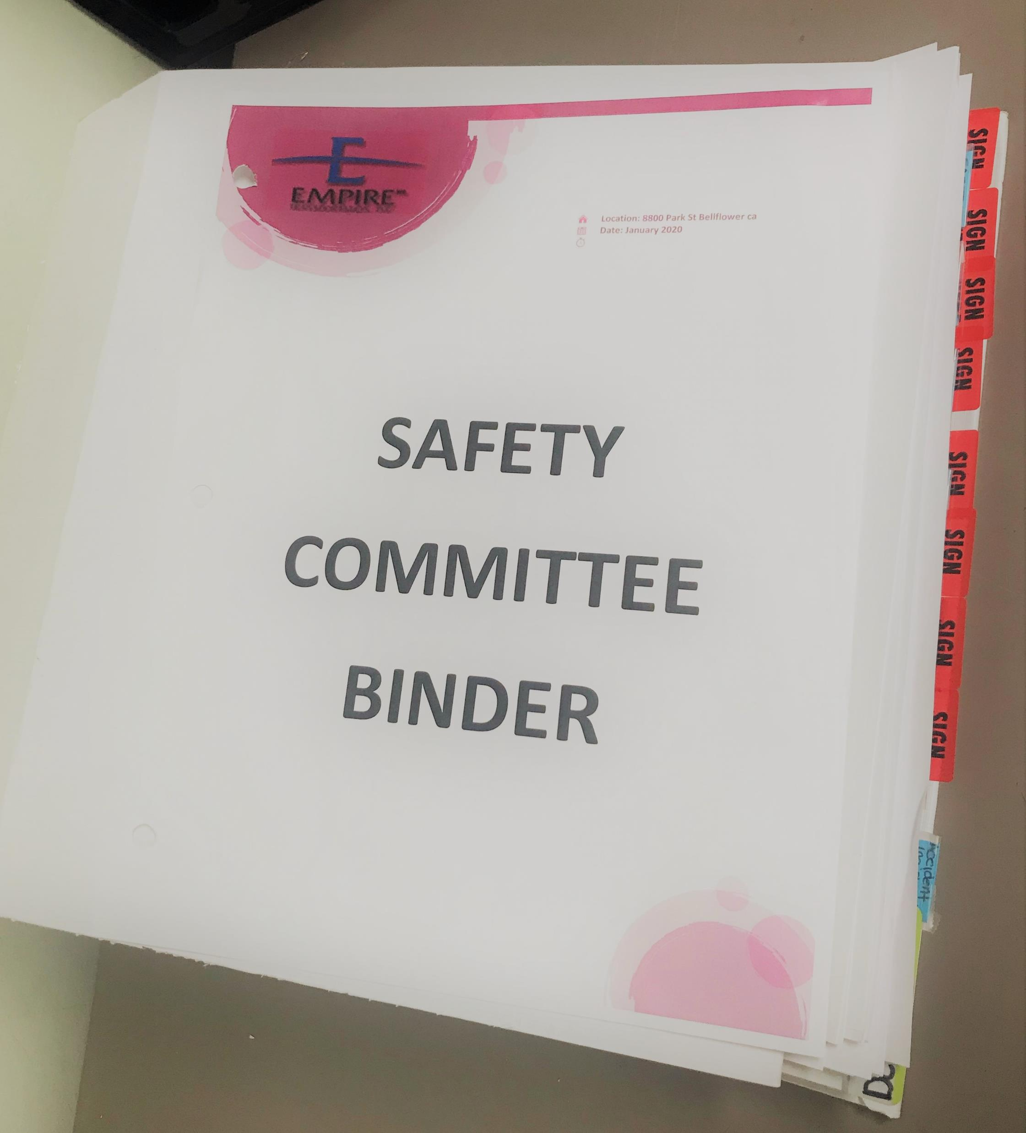
SAFETY BINDER
*Record Keeping.
* Organized by service location.
* Signed Acknowledgements of drivers training & safety meetings. *Handouts provided to drivers.
*Complete accident and injury report.
*OSHA requirements
*TLA’s Reports
*Employee handbook.

Slide 6
“THE MOST IMPORTANT THING TO DO IS TO TRY TO INSPIRE PEOPLE SO THAT THEY CAN BE GREAT IN WHETEVER THEY DO.”
Kobe

