Slide 1

AVOIDING A SIDESWIPE ACCIDENT

Slide 2
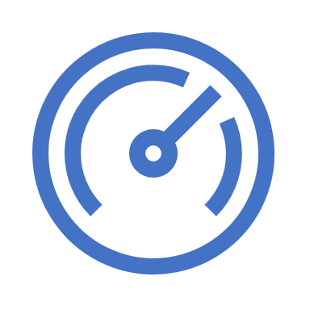
Distracted driving. Distracted drivers, including those who text and drive, often drift outside their lanes. If another vehicle occupies the space in the lane they drift into, distracted drivers can cause a sideswipe collision.
THE SIDE SWIPE INCIDENT

Slide 3
THE MERGE SIDESWIPE INCIDENT
Merging.
As a driver merges into traffic, he must yield to oncoming traffic, fitting his vehicle into the empty space between other cars.
Unfortunately, many drivers fail to safely yield as they pull onto highways and interstates.
Failure to yield can lead to a sideswipe collision when the oncoming driver cannot move out of the way.

Slide 4
THE HIGH CLEARANCE VEHICLE SIDESWIPE
Big trucks and other high-clearance vehicles such as buses.
Some people also refer to sideswipe collisions as blind spot accidents, since they often occur when a driver fails to notice a car in his blind spot.
Blind spot collisions grow more likely when a high-clearance vehicle or one with a large blind spot changes lanes without the driver looking carefully for another vehicle.
Sideswipe accidents involving big vehicles and their large blind spots can cause substantial damage to the other vehicle and its passengers.

Slide 5
Driver Behavior Can Predict Some Crashes
Driver behavior is responsible for most crashes. Bad driver behaviors.
Behaviors as errors and violations affect safe driving. Errors are slips, lapses, and mistakes.
Errors may be dangerous errors or relatively harmless lapses. While violations decline with age, errors generally do not.
Driving errors include seeing another vehicle but misjudging the time available to proceed, failing to yield the right of way, making improper turns or improper stops, failing to see another vehicle, and speeding.
Violations are not errors, but rather the style in which the driver chooses to drive that becomes an ingrained habit after years of driving.
Certain driving errors and violations have been found to be predictive of crashes. The American Transportation Research Institute (ATRI) studied the driving behaviors of over a half-million truck drivers.
*ATRI found the number one bad behavior, increasing the driver’s likelihood of a future crash by 96 percent, was a conviction for ______________________________ What do you think?

Slide 6
DRIVER BEHAVIOR | CRASH PROBABILITY INCREASE
Failure to use or improper signal conviction | 96%
Past crash | 88%
Improper passing violation | 88%
Improper turn conviction | 84%
Improper or erratic lane change conviction | 80%
Failure to maintain proper lane/location conviction | 68%
Failure to obey traffic sign | 68%
Speeding conviction (15 mph over speed limit) | 67%

Slide 7
Pay Attention to Habits
In vetting a new hire or preforming an annual review, a driver’s record can carry a lot of weight, especially if the driver has some bad driving habits listed above.
or other habits that can be just as bad — as not wearing a safety belt while driving, or driving distracted (texting or using a hand-held cell phone), etc.
ATRI recommends that companies:
(1.) become aware of the problem behaviors
(2.) address these behavioral issues “prior to them leading to serious consequences.”
Source: American Transportation Research Institute

Slide 8
THE BLIND SPOT SIDESWIPE
Check your blind spot carefully before changing lanes.
Every time you change lanes, carefully check your blind spot to ensure another car has not slipped into it while your attention drifted elsewhere.
Carefully watch the flow of traffic while you drive, identifying other drivers in your mirrors and keeping track of them when you know you have a lane change approaching.

Slide 9
The Merge Sideswipe Incident
Merge with care. Take Action
Merging causes drivers to need to look in several directions at once. Merging onto busy roads make it difficult to find exactly the perfect place to slip into traffic.
Make sure you have adequate room to pull your vehicle into traffic to complete the maneuver.
When another driver trying to merge, attempt to get your vehicle out of the way, whether that means speeding up to give more room or dropping your speed to allow that driver into traffic.

Slide 10
Avoid A Sideswipe or Merge Incident
Avoid distracted and/or drowsy driving.
As a professional driver, you need to stay alert at all times behind the wheel.
Your primary responsibility remains driving your vehicle safely, not checking your phone for text messages, eating, carrying on a conversation, or adjusting the temperature in the car.
Keep your eyes and attention on the road when you get behind the wheel.
Remember, you are the professional driver on the road.

