Slide 1


Notes:
Gill & Dave Kick it Off!
End of 3rd Quarter!

Slide 2
The Best that We Can Be
You have put the best Employee Health and Safety [EH&S] numbers on the board in the company history.
The Challenge is to put the best EH&S numbers on the board in the industry.
PCI is on the brink of being the leader in EH&S in our industry and that is want we want to achieve.
You are the team that lead the change and the team that will move forward toward the goals.
Stay focused. It works when you work it!
Notes:
Dave.

Slide 3
You have proven it works.
You are working it!
The PCI EH&S plan satisfies the elements required by the CCR Title 8 Section 3203 and those are:
Management commitment/assignment of responsibilities;
Safety communications system with employees;
System for assuring employee compliance with safe work practices;
Scheduled inspections/evaluation system;
Accident investigation;
Procedures for correcting unsafe/ unhealthy conditions;
Safety and health training and instruction; and
Recordkeeping and documentation.
Notes:
Dave:
Not only is it the right thing to do; it satisfied the California Code of Regulations Title 8 Section 3203. All that has been implemented including the weekly calls and monthly training satisfy the regulations. Most importantly they are simply the right thing to do. (As we say, when you satisfy the CCR any other state in the org is covered:)
All the processes you have implemented with your teams, the safety trainings that we conduct are those required to abate the unsafe conditions trending in the organization.
You signed the management commitment and that signed document hangs in the corporate office.
You have the system refined that you use to communicate with the employees.
Ensure that you are documenting the training you conduct and keep it in your safety binders.
Let’s look at some of the training we should be doing now as an organization around incidents experienced this policy period.

Slide 4
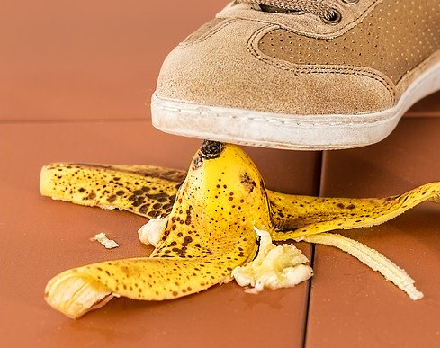
STAY
ALERT!
DON’T GET HURT!
Notes:
Dave:
The second leading cause of reported injuries was Slips, Trips and Falls this year. The Root Cause was identified by the respective safety committees as ‘Employee Not Paying Attention” in nearly 100% of the claims. Let’s Pay attention to that and focus on it.

Slide 5


Go where you are looking,
and look where you are going.
Nose Follows Toes.
See a puddle of water? Walk around it!
See a grease spill? Walk around it!
See that buckled sidewalk? Walk around it.
Walking in a congested area? Watch your step.
When you see a potential hazard, report it immediately.
Walk the Talk! Watch your step.
Notes:
Dave:
The best way to prevent an incident is to be aware and prepared for possible dangerous situations.
When you “go where you are looking and look where you are going” and, report potential hazards immediately, you help reduce workplace accidents and injuries and create a safer work environment for everyone. Look what happens when you fail to pay attention next slide.

Slide 6
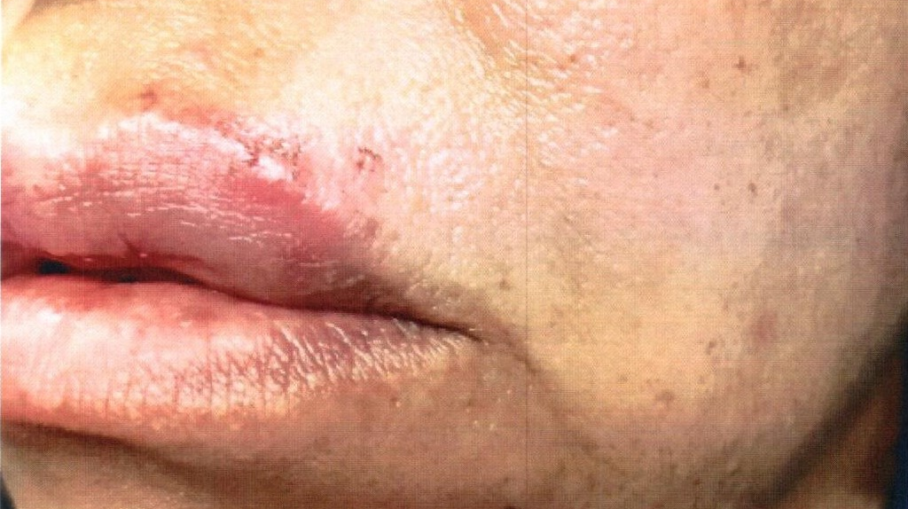
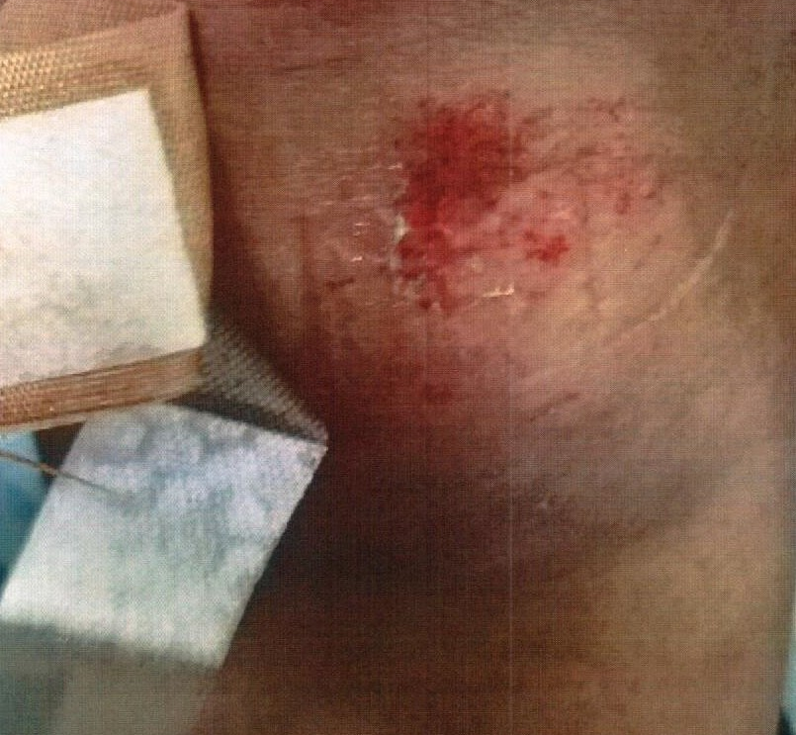
“I TRIPPED OVER A TREE ROOT, DURING MY TEN MINUTE REST PERIOD. BUSTED LIP, LEFT CHEEK BONE, SCRAPPED KNEE. FRACTURED 2 FRONT TEETH.”
Notes:
Dave:
This lady was on her 10 minute rest period. Walked out where the road was rough and took a bad fall. She had to have her teeth repaired. This incident affected her whole life, not just her work life.

Slide 7
Maintain clear, tidy work areas. Report hazards promptly.
Fix or ‘mark’ hazards such as small spills and cluttered walkways.
Use caution when entering/exiting vehicles and equipment and when climbing and descending ladders
Look where you are walking! Stop. Look. Listen.
Use handrails when going up or down stairs.
GET A GRIP. DON’T SLIP!
Notes:
7
Zoe
Slips trips and falls are the leading cause of injuries across the country; across industrial sectors—
Maintain clear, tidy work areas free of clutter by:
Following good housekeeping procedures.
Don’t wait until you’re done with your project or unpacking boxes to throw unnecessary materials away.
Throw materials away immediately, while you’re working. You may save someone from tripping over your materials.
Fix hazards such as small spills and cluttered walkways if you are able to do so;
Use caution when entering/exiting vehicles and equipment and when climbing and descending ladders and stairs; and,
Report hazards promptly before an accident happens.

Slide 8
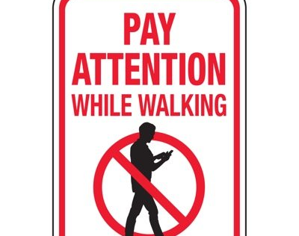

REPEATING AN UNSAFE BEHAVIOR IS NOT A MISTAKE. IT IS A DECISION.
Pay attention to your surroundings.
Look where you are going when you walk .
Do not engage in activities that distract your attention.
Do not read, write, text, or dial while you are walking.
Notes:
Zoe:
Too often our colleagues get injured and the safety committee reports that the individual was not paying attention. That the individual was not looking where they were going.
So,
Pay attention to your surroundings;
Look where you are going;
When walking or going up or down the stairs, don’t engage in activities that distract your attention; and
Do not read, write, text, or dial when you are walking.

Slide 9
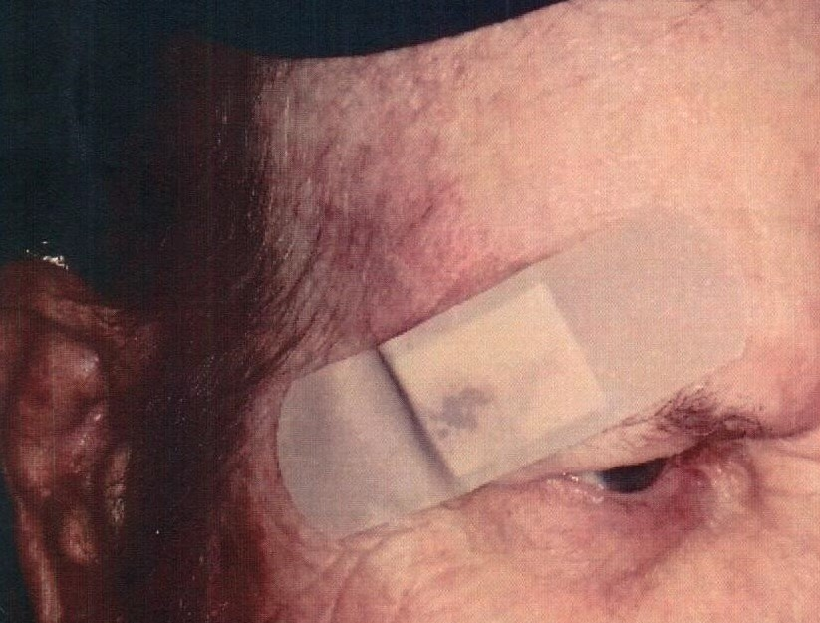
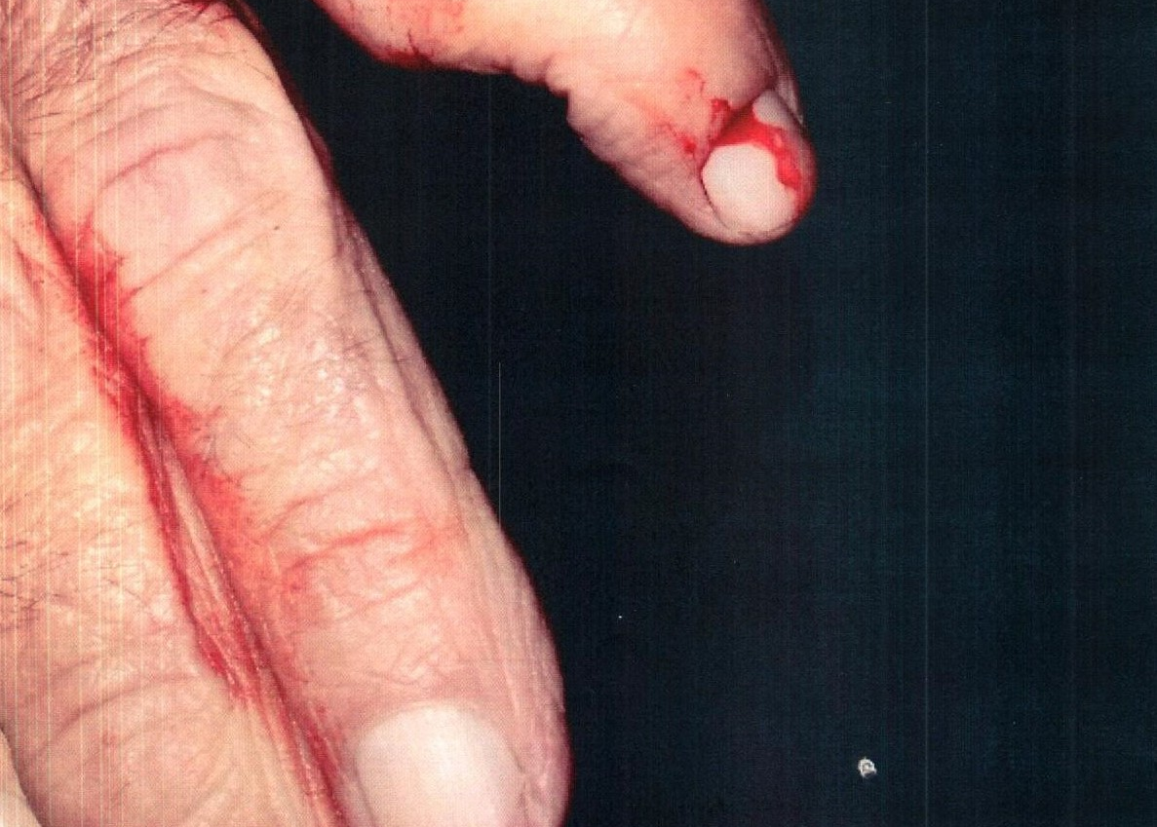
DRIVER WAS FUELING BUS.
TRIPPED OVER FUEL HOSE.
Notes:
Zoe:
The employee tripped over fuel hoses and injured himself. Dislocated his finger and had multiple abrasions.

Slide 10
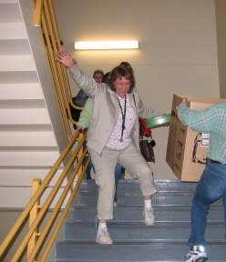
3
POINTS
OF CONTACT
Always use the handrails.
Take your time.
Hold the handrail.
Carry objects in the opposite hand.
Watch where you are going.
Hold on to the handrail.
Notes:
Zoe:
Hold the handrail. Teach your children and grandchildren to hold the hand rails.
The other day a worker told me that as she was descending the stairs in the hospital she kept thinking about three points of contact. She also was thinking about germs, and the flu and was torn as to hold the rail or not.
What would you advise her?
Slips Trips and Falls is the leading cause of injuries.

Slide 11
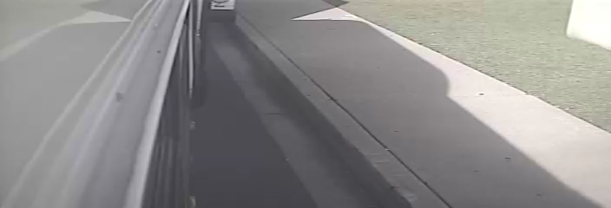
Safe Methods Matter Every Time
Notes:
Zoe:
Behavior.
Drills on the safe methods.
Workforce notification.
Safety messages.
Lead safety daily.
Hand off to Tim Taylor

Slide 12
Distractions
Not Paying Close Attention
Was Identified as the Root Cause of many of the Auto Incidents Experienced this Policy Year.
Notes:
Zoe hand off the next section to Tim Taylor:

Slide 13
Distracted drivers, including those who text and drive, often drift outside their lanes.
If another vehicle occupies the space in the lane they drift into, distracted drivers can cause a sideswipe collision.
Take Action
Avoid Distraction
Notes:
Tim Taylor
Staying alert walking, working, climbing and driving.
4 of our reported injuries this policy period were also MVAs.

Slide 14
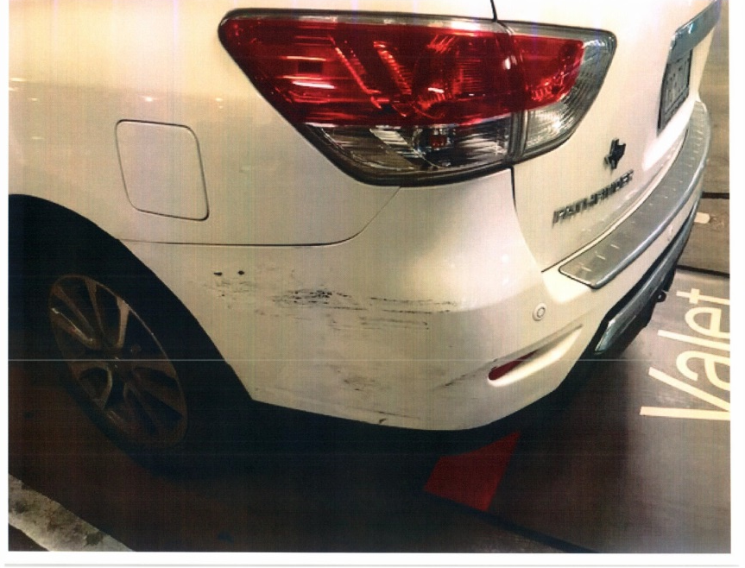
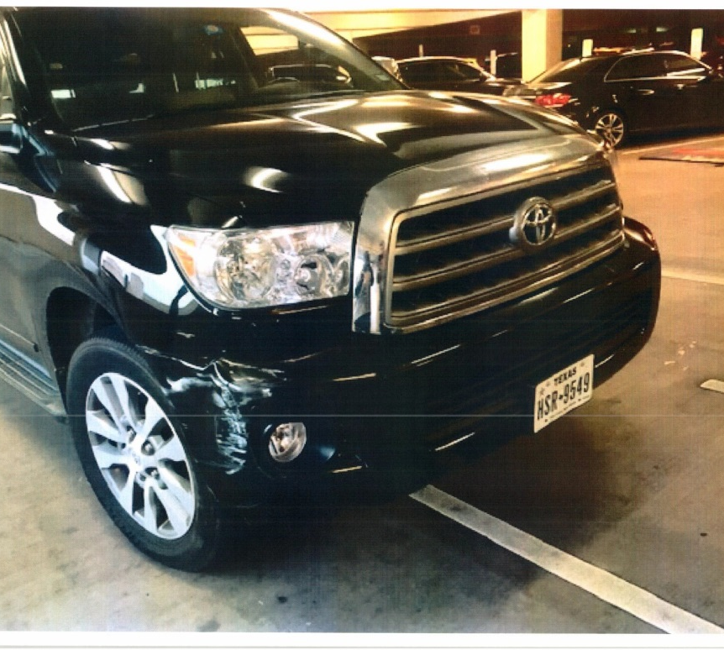
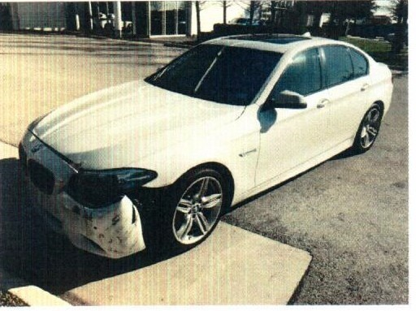
MAKE IT A HABIT TO STAY ALERT. CHECK YOUR BLINDSPOTS. DRIVE SAFETY.
Notes:
Tim Taylor:
Blind spots. Being aware of surroundings. Sideswipes.
Talk about over sized vehicles and how that affects the driver blind spots; seeing cars beside them etc.

Slide 15
Distracted Drivers
Cause
25% of All Crashes
The use of a hand-held mobile telephone according to the FMCSA means:
Using at least one hand to hold a mobile phone to make a call;
Dialing a mobile phone by pressing more than a single button; or
Reaching for a mobile phone in a manner that requires a driver to maneuver so that he or she is no longer in a seated driving position, restrained by a seat belt.
DOT penalties can be up to $2,750 for drivers and up to $11,000 for employers who allow or require drivers to use a hand-held communications device while driving.
Notes:
Tim Taylor:
The Federal Motor Carrier Safety Administration put the rules out on use of mobile phones and being ticketed for an offense can be expensive.
This distraction can be deadly.
Discuss the Dallas team’s cell phone policy.

Slide 16
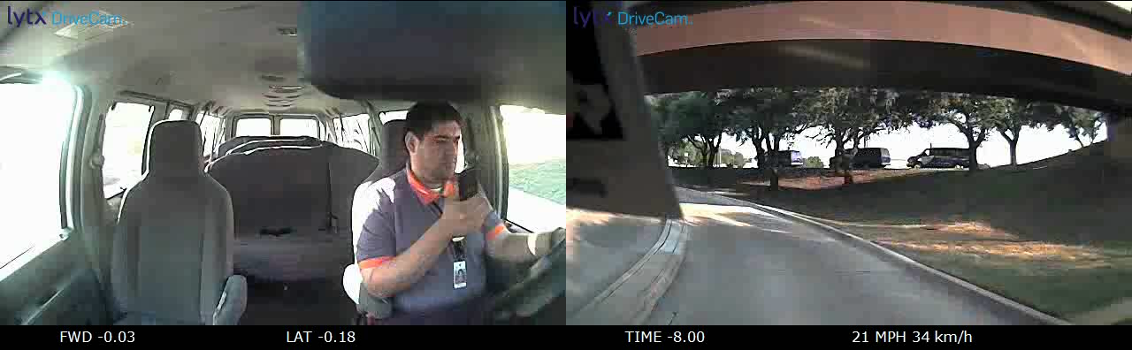
What Was the End Result for This Driver?
Notes:
Tim – cannot wait to hear.

Slide 17
THE BLIND SPOT SIDESWIPE
Check your blind spot carefully before changing lanes or before making the turn.
Every time you change lanes, check your blind spot to ensure another car has not slipped into it while your attention drifted elsewhere.
Carefully watch the flow of traffic while you drive, identifying other drivers in your mirrors.
Check your blind spot when parking, backing and moving the vehicle.
Notes:
Tim:
Blind spot merges/lane changes/even parking or moving automobiles contribute to incidents/injuries. How do over size vehicles blind spots affect driving in tight spaces? How do you correct for that confounder?

Slide 18
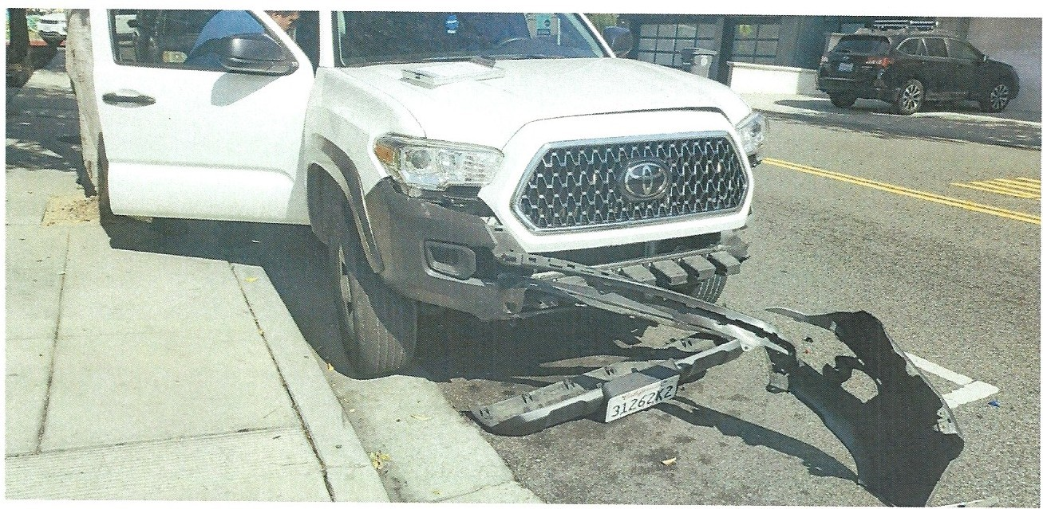
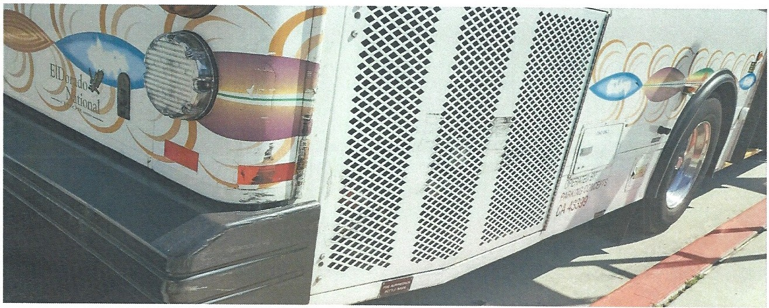
What was the primary fact in charging this collision and the accident committees' ruling on the preventability of the collision, based on facts and laws? Preventable - Driver failed to have control of her vehicle, and was not paying attention to her mirrors or surroundings.
What corrective actions will be taken to prevent further occurrences? Defensive driving, pulling in and out of service stops.
Notes:
Zoe – Brett’s Facility - she didn’t see the truck – blind spot? On the right side of the screen that is the actual report from the packet.

Slide 19
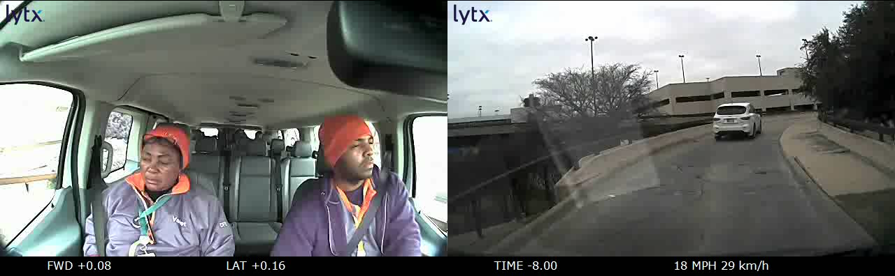
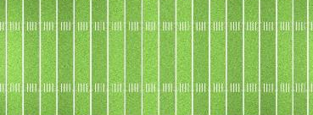
Eyes on the Road Ahead
During a 3-second glance at a cell phone, GPS or other device, a vehicle traveling 55 mph will travel about 250 feet down the road, or nearly the length of a football field!
Glancing away from the road for more than one second can lead to a damaged bumper, a few dents or a life altering incident.
Notes:
Tim time.

Slide 20
Driver Behavior Can Predict Some Crashes
Driver behavior is responsible for most crashes. Bad driver behaviors.
Behaviors as errors and violations affect safe driving. Errors are slips, lapses, and mistakes.
Driving errors include seeing another vehicle but misjudging the time available to proceed, failing to yield the right of way, making improper turns or improper stops, failing to see another vehicle, and speeding.
Violations are not errors, but rather the style in which the driver chooses to drive that becomes an ingrained habit after years of driving.
Certain driving errors and violations have been found to be predictive of crashes. The American Transportation Research Institute (ATRI) studied the driving behaviors of over a half-million truck drivers.
*ATRI found the number one bad behavior, increasing the driver’s likelihood of a future crash by 96 percent, was a conviction for ______________________________
What do you think?
Notes:
Zoe: Behavior – Iron Man – Seasoned pro being doing this all my life driver – when individuals get away with a bad behavior with no incident in reinforces the bad behavior and just like an automotive engine there is a mean time loss to failure; research shows that a high percent of vehicle accidents happen to the older driver; it is not so much the driver errored, but the driver had reinforced bad behavior over time.

Slide 21
DRIVER BEHAVIOR | CRASH PROBABILITY INCREASE
Failure to use or improper signal conviction | 96%
Past crash | 88%
Improper passing violation | 88%
Improper turn conviction | 84%
Improper or erratic lane change conviction | 80%
Failure to maintain proper lane/location conviction | 68%
Failure to obey traffic sign | 68%
Speeding conviction (15 mph over speed limit) | 67%
Notes:
Zoe
The # one violation [bad behavior with the highest probability of crash is Failure to use or improper use of turn signals.
This behavior prediction model is not just for auto mobile incidents/accidents this holds true for individuals in all safe work methods. Bad habits will evidently lead to an incident/accident. Lifting improperly. Working at a desk that is not setup properly. Walking and talking on the mobile phone. Not using handrails up and down steps.

Slide 22
Pay Attention to Habits
In vetting a new hire or preforming an annual review, a driver’s record can carry a lot of weight, especially if the driver has some bad driving habits listed above.
Other habits that can be just as bad — as not wearing a safety belt while driving, or driving distracted (texting or using a hand-held cell phone), etc.
ATRI recommends that companies:
Become aware of the problem behaviors
Address these behavioral issues “prior to them leading to serious consequences.”
Source: American Transportation Research Institute
Notes:
Zoe
In review, safety is an all encompassing process.
Do you use a chair instead of a ladder to reach the top shelf?
Do you rush down stairs while talking on your mobile?
Do you cross across the parking lot outside of the marked walking path?
Do you look at your mobile while walking?
Do you drive your personal vehicle and look at your mobile?
Do you practice the principles of safety without fail?
Make it a habit to work safe.

Slide 23
Wrap Up!
WALK THE TALK.
DRIVE
SAFETY.
Everyday.
Take action. Avoid Distraction.
Get a grip. Don’t slip.
Three Points of Contact on Stairs.
Stay Alert. Don’t get hurt.
Look where you are going and go where you are looking.
Nose follows toes.
Keep your eyes on the road. Keep your hands on the wheel.
Check your blind spots.
Walk the Talk.
THIS TRAINING IS LOCATED IN YOUR PORTAL
Notes:
Zoe
Repeat the safety tips:
The team has done a remarkable job in mitigating risk.
The challenge now is to continue to stay motivated toward the goal.
The challenge is to participate fully in the process to increase your motivation.
The challenge is to inspire others with your behaviors and drive toward the goal.
You have one quarter left in this policy year to drive safety and make this a winning year for your employee group, your district and your organization.
Target Zero
Continue to strive for safety excellence.
Excellence is the result of inseparable operations and employee health and safety leadership.

